Slide 1
1 Kings 3:3-14
Solomon, asking for the right things…

Slide 2
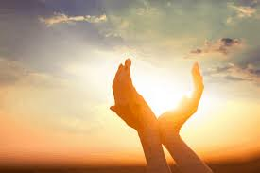
The context for prayer - grace
‘great kindness…’ v.6
Where this takes place
‘I will give you what you have not asked for…’

Slide 3
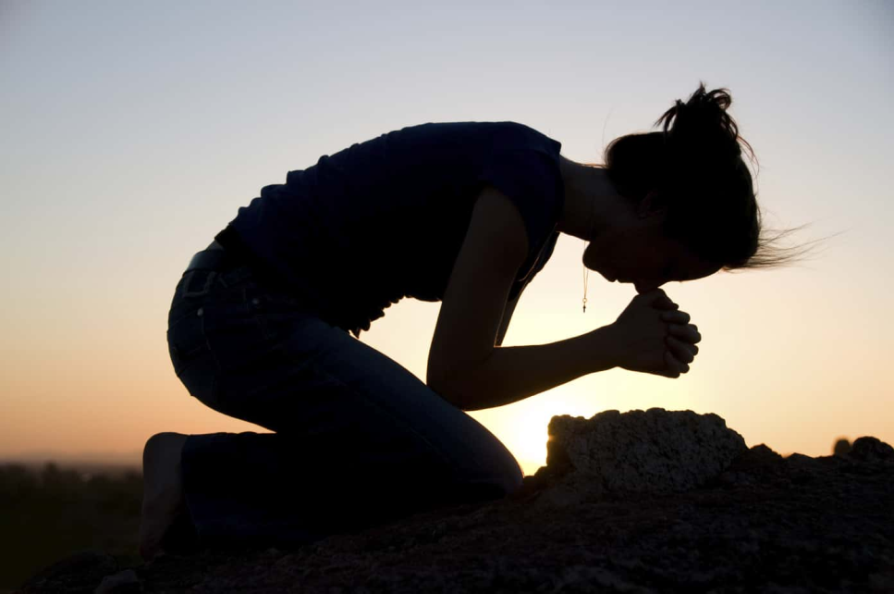
Prayer – the response to grace
Solomon’s prayer shows:
Humility
Responsibility to others
What we pray for shows what we care about…?

